Slide 1
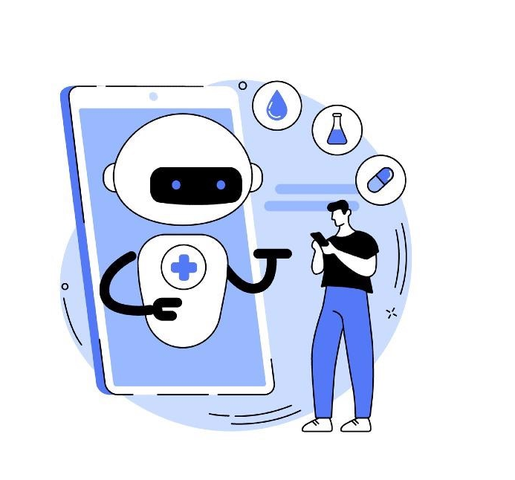
Chatbot Risk Monitoring in Healthcare
Group 1

Slide 2
Problem Formulation
Develop a healthcare chatbot that let the users understand the symptoms they are facing and get a basic diagnosis about the diseases they could be having.

Slide 3
Agenda
Introduction
Project steps
Results
Conclusion
Observations & Future work

Slide 4
1.
Introduction

Slide 5
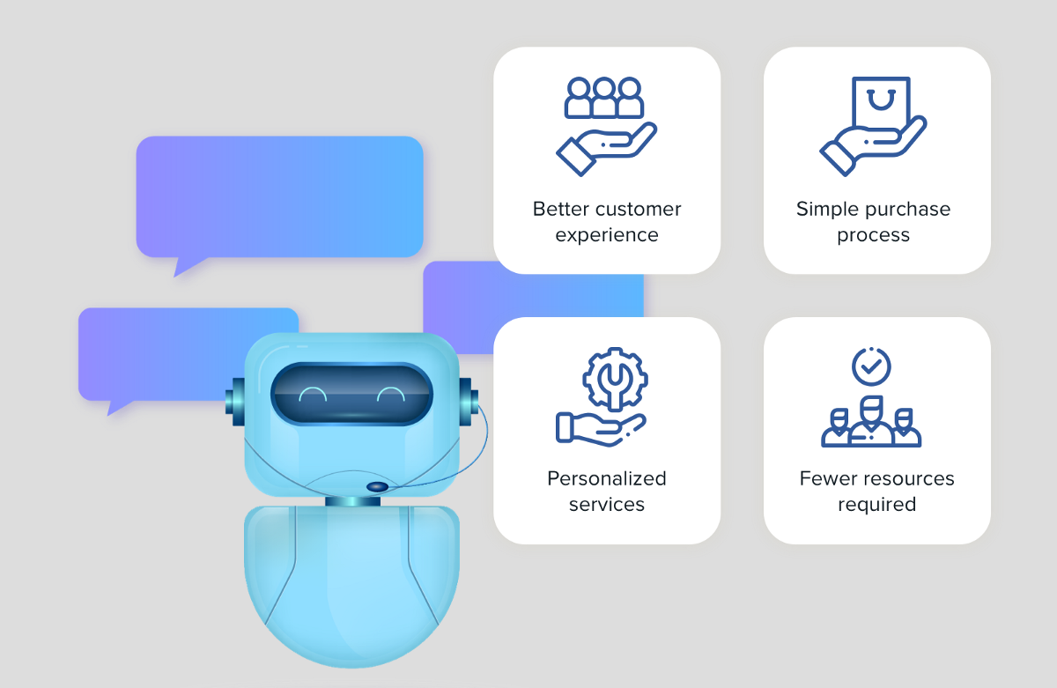
ChatBots Nowadays
Notes:
To being with the definition of chatbot, Chatbots are software applications which help in simulating human like conversations through voice commands or text-based chats or both. Its, a service backed by rules and in some cases Artificial Intelligence which converses with the customer through different platforms of communication.
They have many applications in the domain of customer service, request routing or information gathering. A research by Gartner Inc. predicts that by the end of 2020, 25% of consumer services & support operations will be using Virtual Customer Assistant (VCA) technologies including chatbots.

Slide 6

Chatbot in Healthcare
Chatbots in the healthcare provides either predictive diagnosis or other assistantships like booking an appointment.
Notes:
help doctors and medical staff to deal with patients in better way and reduce their efforts with the help of technology. Chatbots can play a major role in reshaping the healthcare industry by providing either predictive diagnosis or any other assistantships like booking an appointment.

Slide 7
Previous work
Studies are based on to recognize emotions classification using AI methods.
A chatbot that aims to make a conversation between human and machine. Here the system stores the knowledge database to identify the sentence and making a decision to answer the
A chatbot which implement pattern comparison in which the order of the sentence is recognized and response pattern is saved.
Notes:
Here the studies are based on to recognize emotions classification using AI methods. The studies train emotions classification models from a lot of labelled data based on recurrent neural network (RNN), deep learning, and convolutional neural network.
This chatbot aims to make a conversation between human and machine. Here the system stores the knowledge database to identify the sentence and making a decision to answer the question. The input sentence will get the similarity score of input sentences using bigram. The chatbot knowledge is stored in RDBMS
The chatbot implemented using pattern comparison in which the order of the sentence is recognized and saved response pattern. Here the author describes the implementation of the chatbot Operating system, software, programming language, database and how results of input and output are stored. Here the input is taken using text() function and other punctuation is removed using trim() function and random() function is used to choose a response from the database. The chatbot is used for an entertainment purpose.

Slide 8
2.
Project Steps

Slide 9
Proposed Project
Collect Dataset
Data Preprocessing
Input Text preprocessing
Syntactic Similarity
Semantic Similarity
Classification and Clustering
Association rule
Challenges and future work

Slide 10
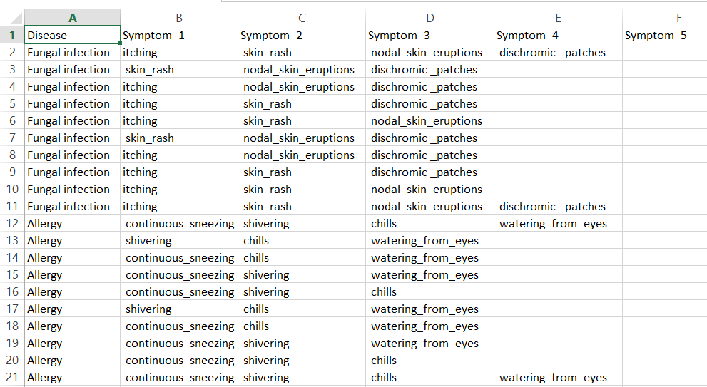
1- Dataset
Original Datasets:
Disease with symptoms
Notes:
https://www.cancer.gov/publications/dictionaries/cancer-terms/def/diagnosis
https://en.wikipedia.org/wiki/Prognosis
https://www.cancer.gov/about-cancer/diagnosis-staging/diagnosis

Slide 11
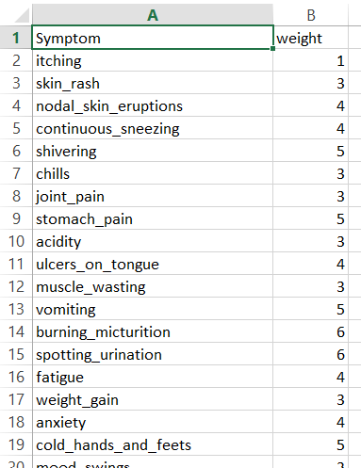
Symptoms’ severity

Slide 12
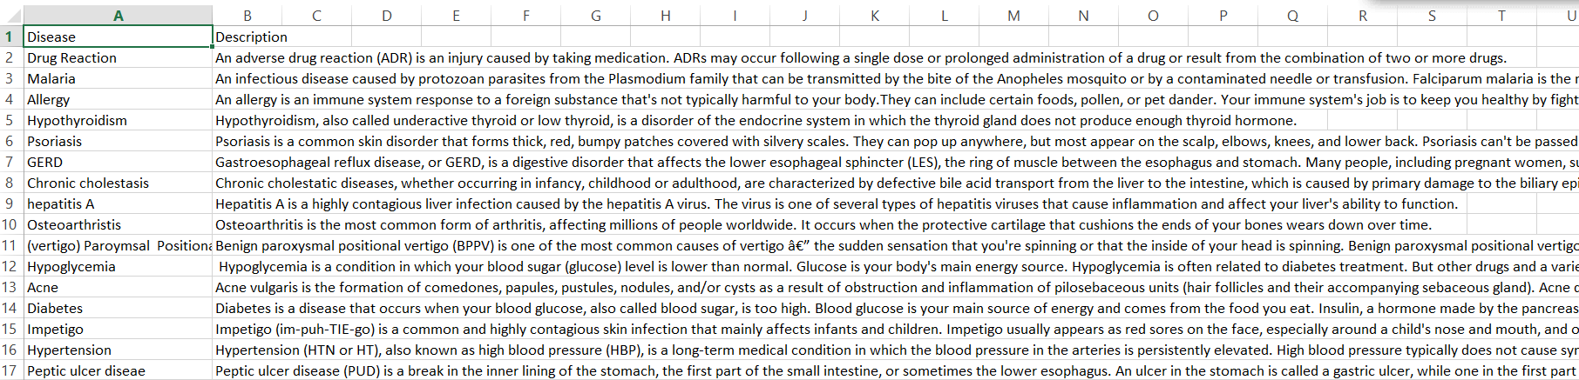
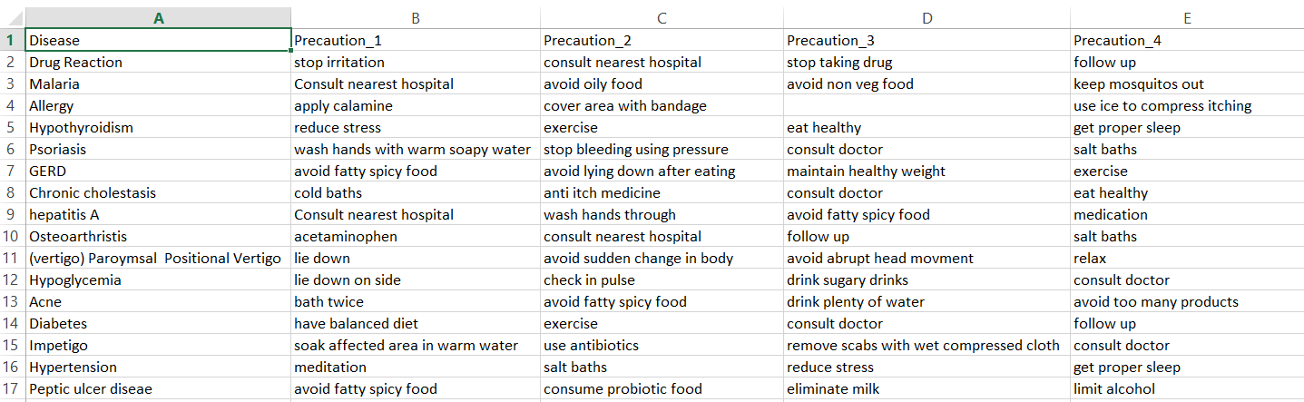
Disease description
Disease precaution

Slide 13
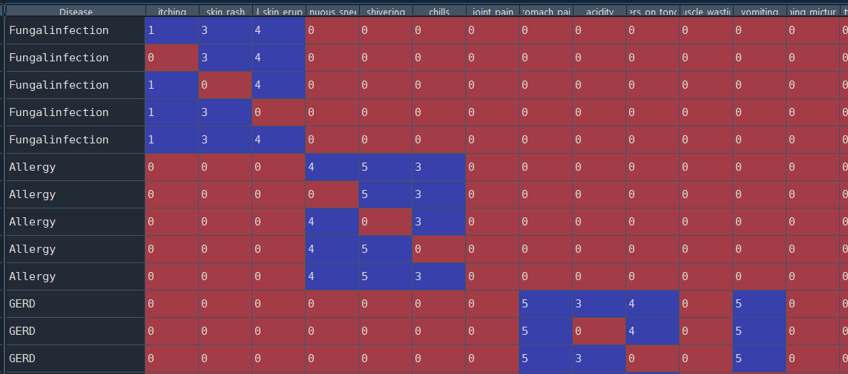
Preprocessing
Remove whitespaces
Remove duplicates (len_before= 4920, len_after=304)
Set each row to a unique disease and each column with unique symptom and fill the cells with the symptoms weight.

Slide 14
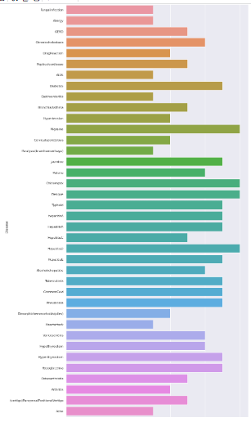

Exploratory Data analysis
Visualization of existence diseases

Slide 15
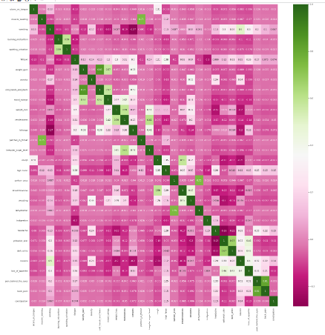
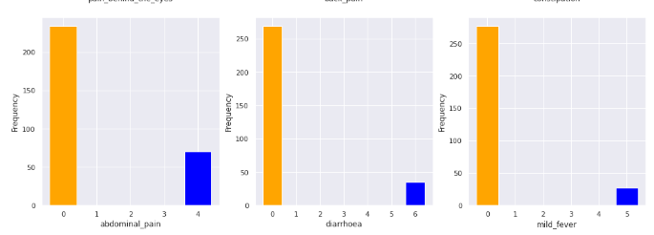
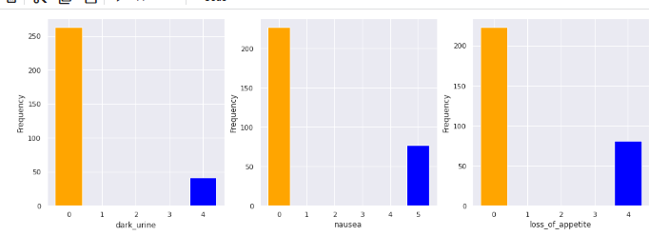
Cont.
linear relationships between some of features using correlation heatmap: for example which symptoms occur together?
Visualisation of some features

Slide 16
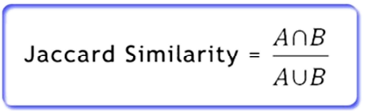
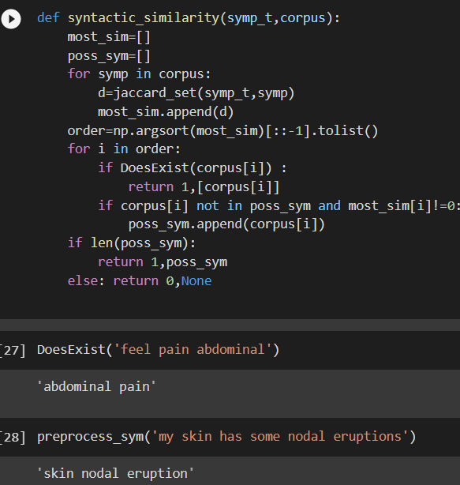
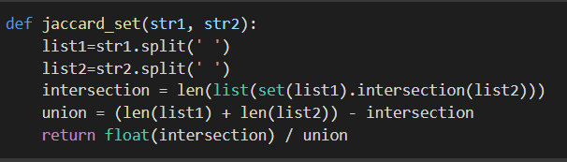
Syntactic Similarity
Calculate Jaccard Similarity to identify the similarities between sentences
Notes:
The syntactic similarity is based on the assumption that the similarity between the two texts is proportional to the number of identical words in them (appropriate measures can be adopted here to ensure that the method does not become biased towards the text with a larger word count,
the syntactic similarity value can be obtained by constructing measures around the word count of the two documents,

Slide 17
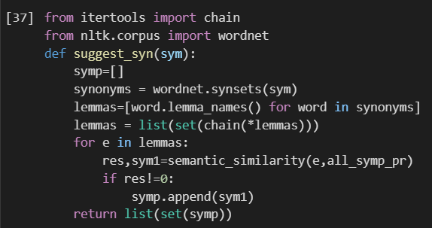
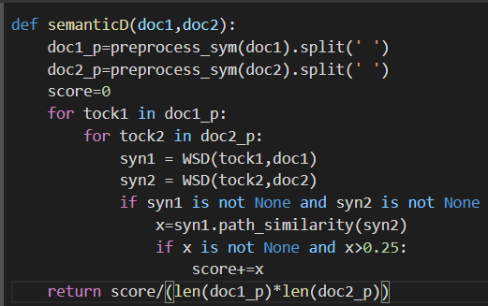

Semantic Similarity
Notes:
semantic similarity focuses more on the meaning and interpretation-based similarity between the two texts.

Slide 18
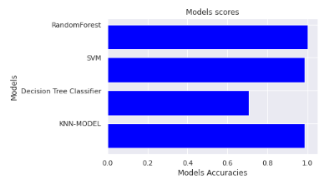
ML Models(classification)
We apply 4 models on the dataset for classification approach(Decision Tree & SVM & Random forest classifier & KNN).

Slide 19
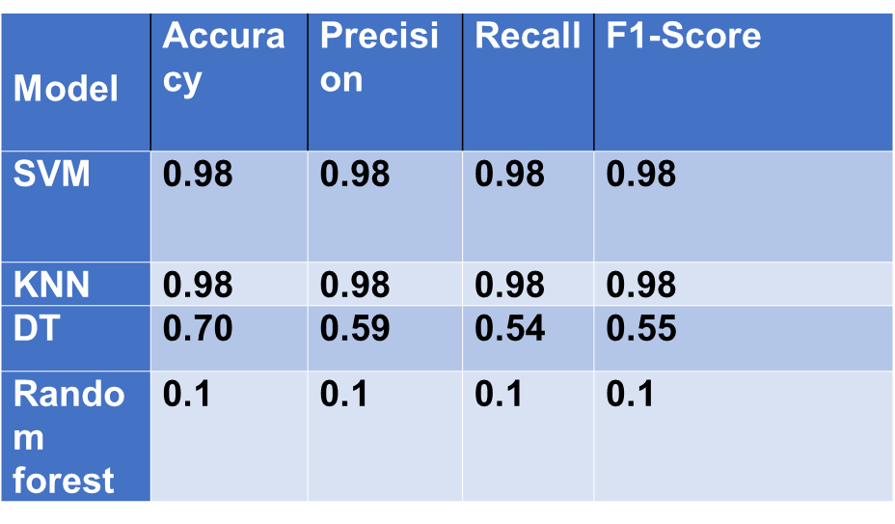
Evaluation

Slide 20
Limitations of classification algorithms:
Notes:
~ It just tells the associated disease class. In our situation, we need to dig into the details of the disease and the associated symptoms.
We want to know whether the provided details are sufficient or if we need more details and what are the required details to ask back the patent.

Slide 21
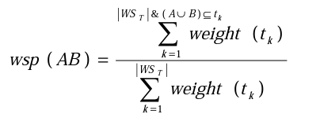
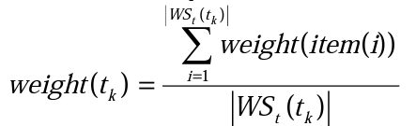
Association Rules:
[Set of Symptoms] → [Disease]
Association Rules with weights
Notes:
We thought of AR as a way to solve the limitations of the classification algorithms.
To formulate the rules we considered the symptoms as the antecedents and Diseases as consequents.
Each symptom has a severity value. We want to make use of that in evaluating the rules. We’ve found a paper that was talking about weighted association rules and we’ve used it in evaluating the weighted support. https://eprints.soton.ac.uk/257986/1/331.tao.pdf

Slide 22
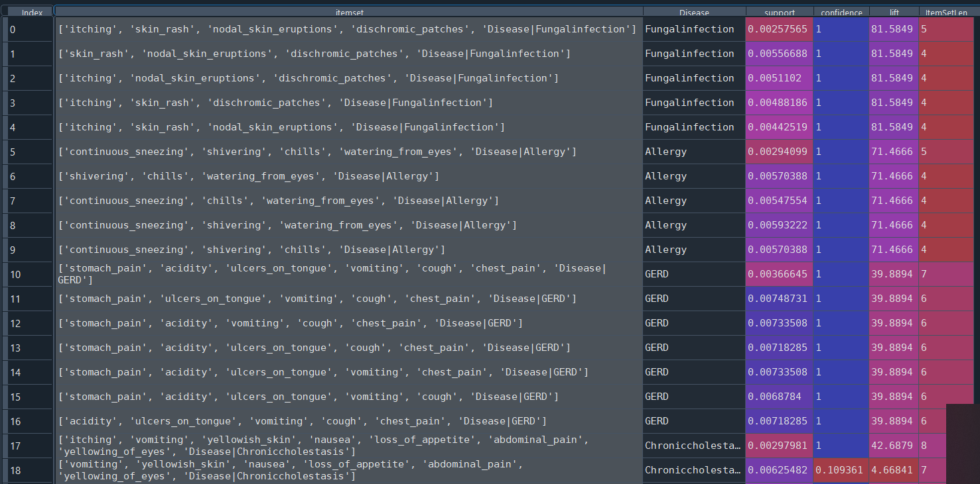
Rules are predefined

Slide 23
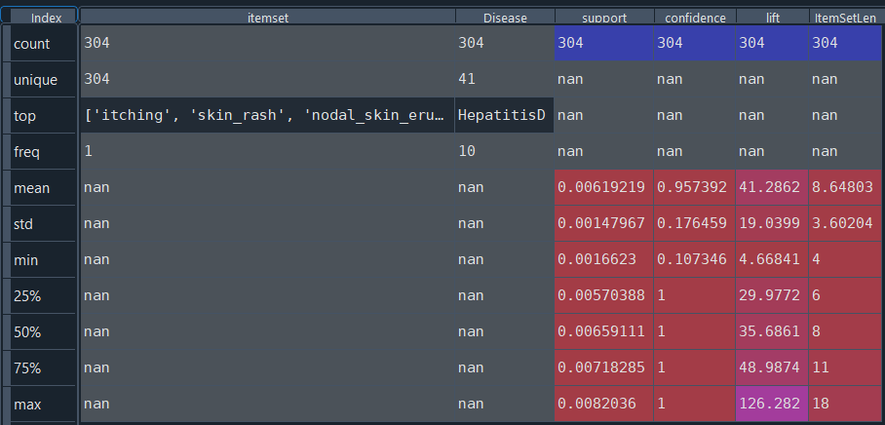
Rules data summary.
Lift Threshold.
Insufficient input symptoms
Notes:
Lift Threshold.
~ In order to know whether the input symptoms are sufficient or not. We’ve evaluated the lift and compared it with our lift threshold which has been set to the minimum lift value of our predefined rules. Approximately 4.
Insufficient input symptoms.
~If the input symptoms set is evaluated to be lower than our threshold.
We search for the most important rule which has the highest lift and its item set contains the input symptoms and asks the patent again whether or not he has any of the remaining symptoms from that rule

Slide 24
Challenges
Few Dataset. 41 diseases with 304 rules.
Lake of important information:
Disease severity.
Symptom priority and importance.
Symptom duration.
Notes:
~we have the symptoms severity level but we don’t have the disease severity. Also for each Disease, we should apply a priority and importance level for the symptom with respect to that disease. Also for how much time we should consider each symptom.
Actually, we’ve consulted a pharmacist doctor, and he said it’s hard to be generalized but he follows some guidelines in the diagnosis process.
But these guidelines require more info like what we’ve explained. And we look forward to collect this information

Slide 25
Future Work
Collect and extract more valuable information and gather a higher quality dataset. With the help of the doctors and other sources of information like books.

Slide 26
Thank You

